Slide 1
IoT based Home Automation System
Presented By –
Noor Al Din Ahmed – 1310607043
Rahatul Aine - 1220812042

Slide 2
Abstract
Home automation usually signifies increased automation of household appliances through electronic means. There is an increasing demand for smart homes, where appliances react automatically to changing environment conditions and can be easily controlled through one common device.
Our purpose is to build a unit that can monitor and control the electrical home appliances from anywhere in the world using a hand held mobile device. And also, to keep the automation of homes at a reasonable price with parts that are available within our country.

Slide 3
Aim and Objective
To build a home automation system that will improve comfort, enhance accessibility, minimize operating costs, simplify use of technologies, and promote energy efficiency and convenience.
To enable people who are out of their homes most of the time to monitor their homes in real time from anywhere in the world.
The physically challenged people can easily control basic appliances through cell phone using an application.
Using this system people can know what appliances are running, what is the condition of a room and how much power is being consumed in that particular room, in real time.

Slide 4
Current Status
There are solution like this already available in the market.
But they are very expensive costing $100-$1000.
Most of the devices communicate using Bluetooth, wifi, ethernet, voice recognition etc.

Slide 5
‘What is new’
Using a Zero Crossing Detector
A Thyristor based switching circuit
User will be able to control the power flow for each outlet.
It is very affordable.

Slide 6
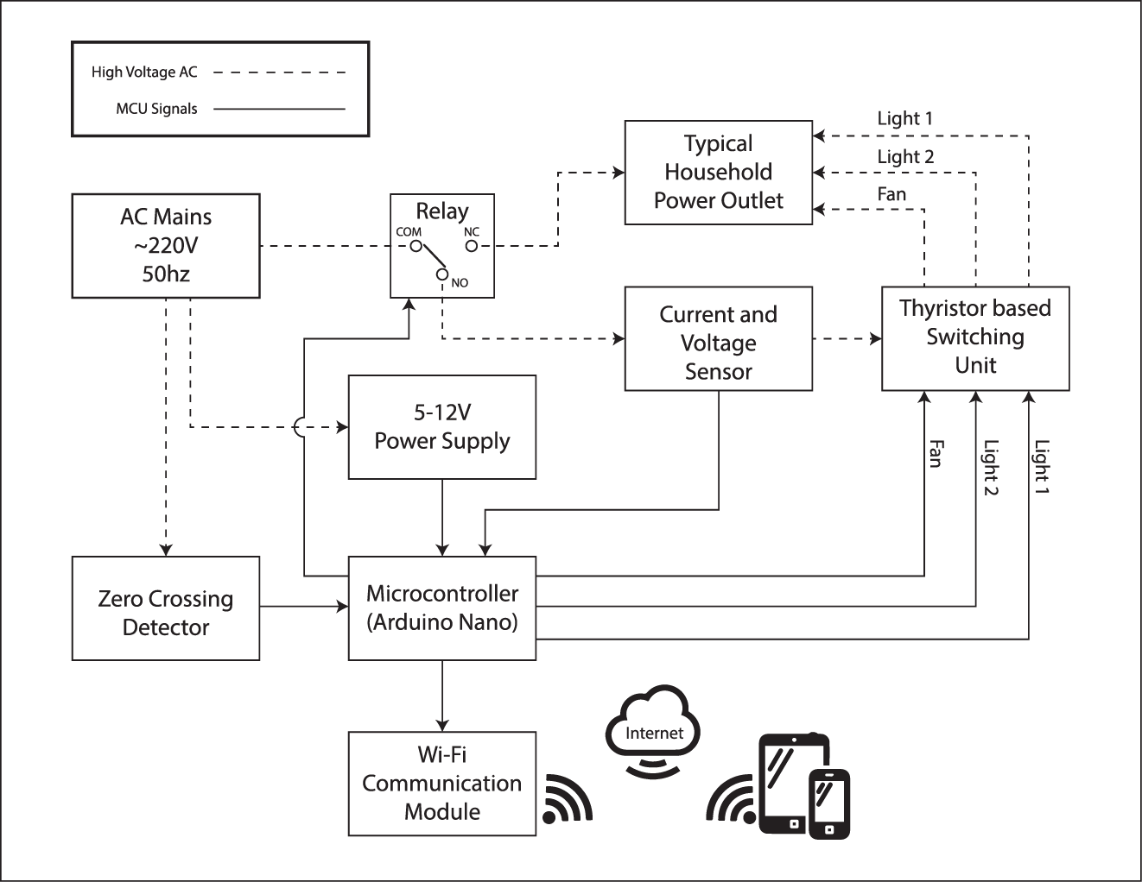
Plan of work (Hardware)

Slide 7
Timeline
Tasks | Start Date | Duration in week
Simulating various ZCDs | 13/07/2017 | 1
Building the optimal ZCD | 20/07/2017 | 1
Simulating the Voltage Sensor | 27/07/2017 | 1
Building the optimal voltage sensor | 03/08/2017 | 1
Simulating the switching circuit | 10/08/2017 | 1
Making the switching unit | 17/08/2017 | 1
Programming the microcontroller for testing | 24/08/2017 | 2
Assembly of the whole unit | 07/09/2017 | 2
Connecting the MCU to WiFi | 21/09/2017 | 2
App Development | 05/10/2017 | 4
Test Run | 02/11/2017 | 2
Troubleshooting and improvising | 16/11/2017 | 3

Slide 8
Budget and Financing
Item Name | Ratings | Quantity | Total
Microcontroller | Arduino Pro Mini | 1 | 180tk
Wi-Fi module | ESP-8266 | 1 | 250tk
Current Sensor Module | ACS712-30A | 1 | 220tk
Vero boards | Strip Board 5x7cm | 2 | 180tk
Relay | SRD-5VDC-10A | 1 | 20tk
Passive Devices | Various | - | 100tk
Triac | BT134 4A 500V | 10 | 50tk
Optocouplers | EL817 | 5 | 20tk
Optocouplers | MOC3021 | 5 | 75tk
Wires | - | - | 100tk
Diodes | 1N-5819 | 10 | 100tk
Transistors | 2N3904 NPN | 10 | 30tk
SIL pins and connectors | various | - | 200tk
Total |  |  | 1525tk

Slide 9
Plan of work (Software)
In order to make a web based Home Automation system, the following tasks need to be done:
Learning about XML - learn basic terminology of XML and practice tasks.
Database – gather knowledge on creating database, writing SQL statements.
Web Development – gather idea on web development, learn the essential coding skills.
Web Server – learn about web server and will try to make a simple web server.
Test run – apply a test run to check if the server works properly.

Slide 10
Timeline
Tasks | Start Date | Duration in week
XML | 09/07/2017 | 2
Database | 24/07/2017 | 3
Web Development | 14/08/2017 | 3
Web Server | 04/09/2017 | 4
Test run | 02/10/2017 | 1
The chart above shows when the tasks will be completed to make the web server.

Slide 11
Product Specification
User can control their home appliances through their cell phone using an application/software.
Voltage regulation is possible through mobile application. For example: Dimming lights and speed regulation of a fan.
Automatic ambient light monitoring and adjusting.
Real time temperature and humidity sensing and monitoring through mobile application.
The system can notify users how much power is being consumed in the room through mobile devices.
Motion sensing capabilities to see if anyone is in the room.
Appliances can be controlled from anywhere around the world.
The unit can be implemented in an already existing traditional system.

Slide 12
Conclusion
Home automation system offers a variety of services and functions. This system is intended to deliver services to customers who have a large family or are a household of one.
This system will make users life easier and will save their amount of labour, time and energy. They can control their electrical devices via these Home Automation devices and control actions through Mobiles.
This design will be simple and affordable to many users.

